Slide 1
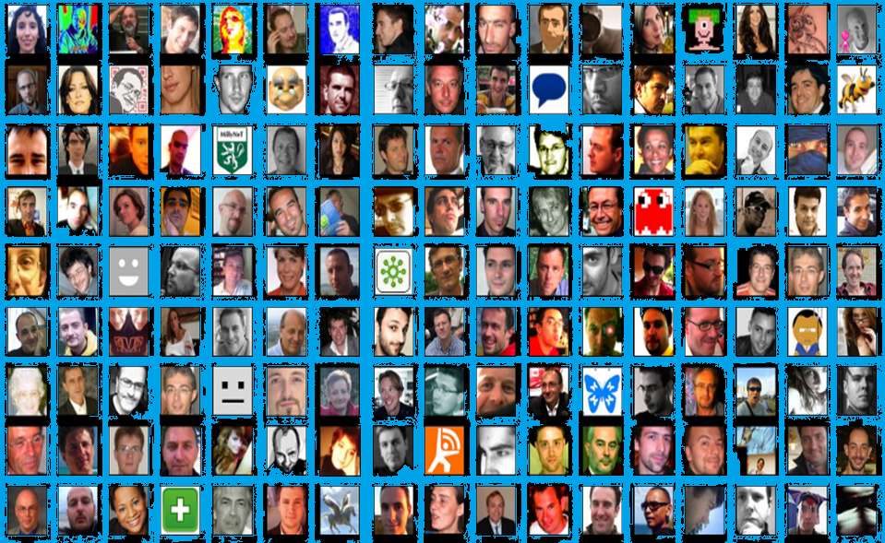


Getting started with Twitter
#schoolnetsa11

Slide 2



Intel ICT in the Classroom Conference 2011
Twitter- Our back channel tool
We will be using twitter as our backchannel tool during the conference. This means that you can…
Connect and network with one another
Have discussions.
Share links and resources on the fly!
Keep up with conference news and information.
Go to www.twitter.com
or on your cellphone: m.twitter.com

Slide 3
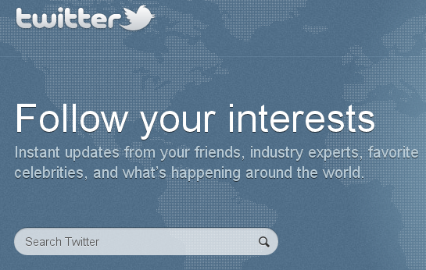
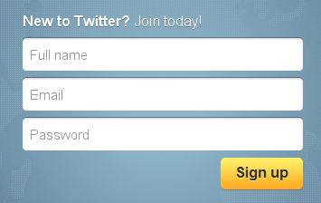
Intel ICT in the Classroom Conference 2011
Step 1: Register for a twitter account
Go to www.twitter.com
Enter your Real name
Enter your e-mail
Choose a password
Click on “Sign Up”
You can access Twitter from your mobile phone by going to your mobile browser and typing in m.twitter.com or using the twitter app on your smartphone.

Slide 4
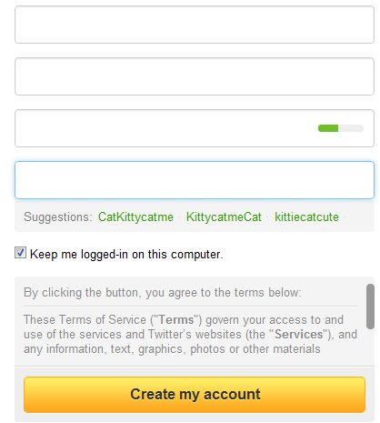
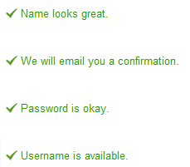
Intel ICT in the Classroom Conference 2011
Step 1: Register for a twitter account
Enter your REAL name. Twitter is about REAL people
Kitty Cat
kittycatme@gmail.com
*************
Insert your e-mail address and password
Kittycatclever
Tick only if you do not share your computer!
Choose a username that will most accurately
describe you
You will receive an e-mail with a link to click on to confirm your registration.

Slide 5
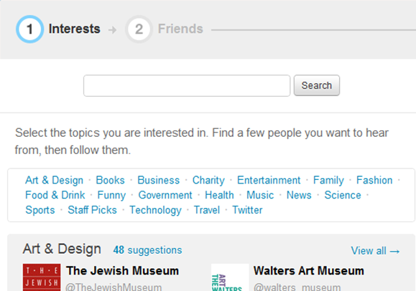

Intel ICT in the Classroom Conference 2011
Build your network of interest
By following people that have the same interests as you or educational leaders and organisations, you can create a powerful learning network on the fly.
Type in a keyword that describe your interest
mathematics
Click on a category that interest you
You can skip this step by just clicking on Next step at the bottom of your screen.

Slide 6
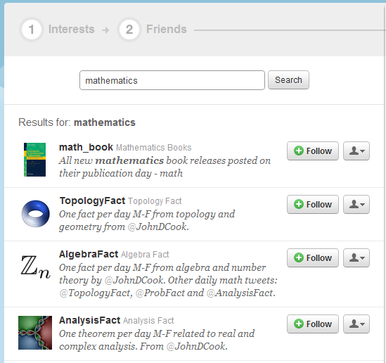


Intel ICT in the Classroom Conference 2011
Build your network of interest
Your keyword search will display selected people who would be good to follow.
Click on Follow to follow the peeps twitter stream
Click Back to: Interests to choose further interests and peeps.

Slide 7
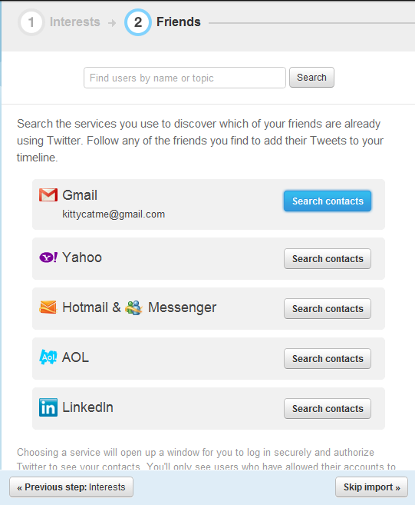
Intel ICT in the Classroom Conference 2011
Twitter- Build your network of interest
See who of your friends / colleagues are already using twitter.
By giving
Gmail
Yahoo
Hotmail/AOL
Linkedin
permission to share your contacts, it will auto search who is already on twitter and display a list for you to follow.
You can skip this step by just clicking on Skip import at the bottom of your screen.

Slide 8
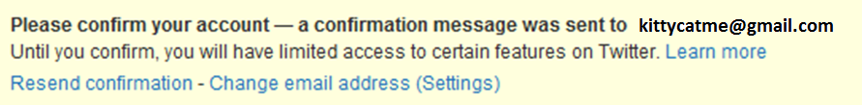
Intel ICT in the Classroom Conference 2011
Twitter- Confirm your account
Check your e-mail inbox for an e-mail from Twitter.
Click on the confirmation link contained in the e-mail.
You will now be able to receive direct messages directly to your e-mail inbox.
You will still be able to use Twitter even if you have not confirmed your e-mail.
Activating your e-mail will give you access to many other services on twitter

Slide 9
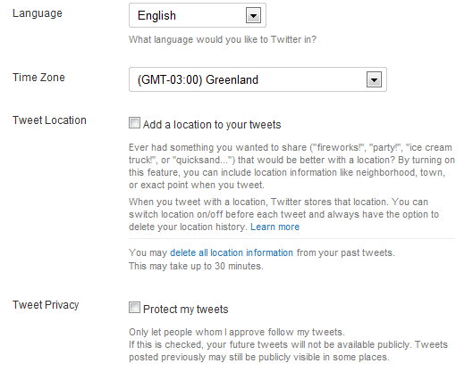
Intel ICT in the Classroom Conference 2011
Twitter- Tweaking your settings
Make sure that you adjust your basic settings...
Click on Settings → Account
(Dropdown under your name top right)
Your real name, username and e-mail will be filled in already
Change your time zone to
(GMT+2) Pretoria
Choose if you want others to see your location (you will then be able to locate others near you)
Un-tick Protect my tweets.
Do NOT protect your tweets – your post will not display in the conference stream if you do!!
Notes:
Suggestions: By using your name, other like minded people can find you. Your BIO is very important. Don’t use your work name (why not?) but rather state your interest eg A biology teacher who loves technology.

Slide 10
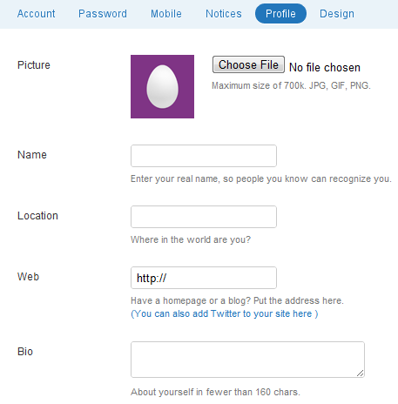
Intel ICT in the Classroom Conference 2011
Twitter: Complete your Profile settings
Not updating your Profile settings is like leaving your house without putting clothes on......
Click on Settings → Profile
Upload a photo of yourself
(please hatch your egg NB!!!)
You can adjust your name. Be real!
Where are you based?
Insert your /organisation’s web address or blog.
Say something about yourself that will give potential followers a sense of what you do/are interested in.
Peter De Lange
Pretoria South Africa
http://ict4champions.co.za
Love learning, sharing and social media
Make sure that your Bio is professional and take your privacy into account.
Notes:
Suggestions: By using your name, other like minded people can find you. Your BIO is very important. Don’t use your work name unless you will be tweeting on behalf of your organisation or brand.

Slide 11
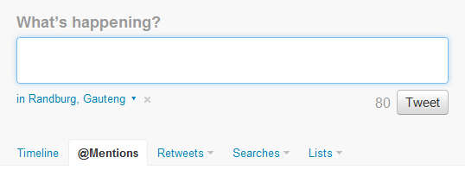
Intel ICT in the Classroom Conference 2011
Twitter: Your first conference tweet
Go ahead, and introduce yourself so that we can see you in the #Schoolnetsa11 conference stream! Remember you only have 140 characters!
Start typing
You will see how many characters you have left next to the Tweet button
Your current location
Click on the Tweet button to send.
Hi am listening to @C4lpt at #schoolnetsa11
If you cannot say it in 140 characters, feel free to do a few tweets…….tweet ……tweet……..
Don’t forget to add the conference tag #schoolnetsa11 to your tweet (anywhere)

Slide 12
Intel ICT in the Classroom Conference 2011
Twitter etiquette
DO:
Use good language
Share valuable resources and shorten them (bit.ly).
Ask questions and give answers/opinions/support.
Think before you tweet!
Add value to your network………
The conference resources and bookmarks can be found here: http://bit.ly/schoolnetsa11
DON’T:
Use ALL CAPS (it is screaming)
Tweet in an “altered state”
Forget to credit those tweets that you are passing on (re-tweeting- RT)
Demean or critise others
Remember that your tweets are very public and reflect on you as a person and as a representative of an organisation.
Notes:
It is okay to do personal tweets in between as long as you make sure that you are always thinking about personal privacy issues as well as making sure that you add value to your network and support your brand.

Slide 13
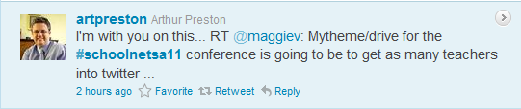
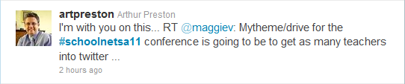

Intel ICT in the Classroom Conference 2011
Reading your tweet stream
Tweets are in reverse chronological order, according to time, with the newest at the top.
If you click on Home (top right) and Timeline, you will see all the tweets of the people you are following.
If you want to reply to or retweet a tweet, hover your curser over it to see the Reply or Retweet options or add @theotherpeepsusername to your tweet.
To read anybody’s tweets, click on their twitter name or picture eg www.twitter.com/maggiev and read on the pane to the right. (or click the arrow to the right)
If you want to find a specific tweet again you can mark it as a favourite, using the star (Favourite) option below the tweet.

Slide 14
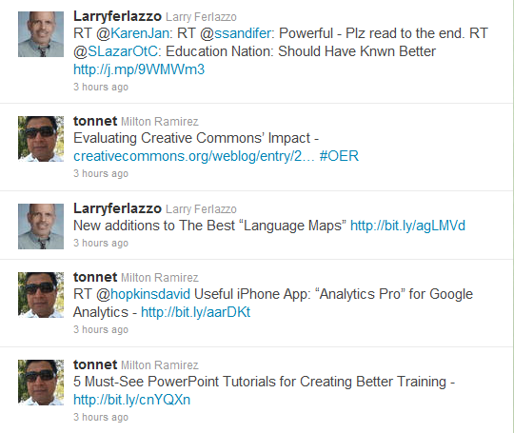
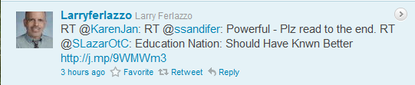
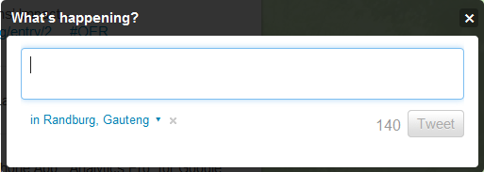
Intel ICT in the Classroom Conference 2011
Re-tweeting
Re-tweeting is a way to pass on valuable links and resources from your network to your followers
Hover curser over tweet
Click on Retweet below
Add RT for “retweet” (it is short!) in front of the @persons’s name
RT @kjarrett RT @shareski RE: PLCs. "If everything is mandated and structured. It fails. Same with classrooms."
Re-tweeting people’s tweets also make them aware that you value their contribution and they will probably follow you, building a stronger network
Notes:
We can re-tweet what others are tweeting about by adding RT and the @theotherperson to our re-tweeted tweet! It is considered bad etiquette to not give credit to those tweople/peeps (people) in your twitter network who first alerted you to the resource url! So make RT an essential ingredient of being polite. Plus it can also assist in building your learning network as people tends to follow those who often RT them!
To copy (for novices) just highlight the tweet and push Ctrl-C on your keyboard. Then click in the message window and push Ctrl-V to paste the tweet into the window. Add RT to the front of the message.

Slide 15
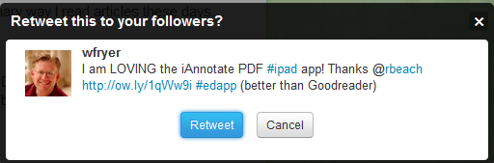
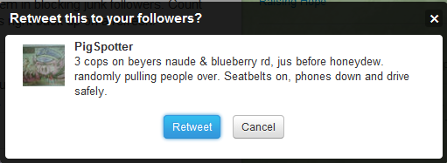
Intel ICT in the Classroom Conference 2011
Re-tweeting
The value of retweeting is that you become a filter for your followers and create relationships for a powerful network.
Check the resources first before passing it on!
Think if you REALLY want to pass it on!
Re-tweeting means that you value the information and feel that it is worthwhile to pass on. It adds value to your followers experience.
Notes:
To copy (for novices) just highlight the tweet and push Ctrl-C on your keyboard. Then click in the message window and push Ctrl-V to paste the tweet into the window. Add RT to the front of the message.

Slide 16
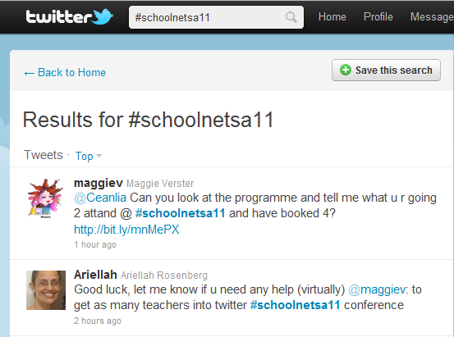

Intel ICT in the Classroom Conference 2011
How do you follow the conference stream?
Everything that will be happening will be in the conference twitter stream!!!!!
Type #schoolnetsa11 into the search window.
Click on Save this search so that you can get back to it quickly!
If you do not see your tweet in the conference stream it means that you have not added the hashtag #schoolnetsa11 to it (anywhere)
Notes:
To copy (for novices) just highlight the tweet and push Ctrl-C on your keyboard. Then click in the message window and push Ctrl-V to paste the tweet into the window. Add RT to the front of the message.

Slide 17
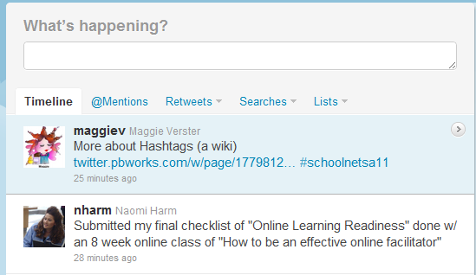

Intel ICT in the Classroom Conference 2011
How do you follow the conference stream?
Everything that will be happening will be in the conference twitter stream!!!!!
To get back to your saved conference search, click on Home →Searches
Click on the saved #schoolnetsa11 search
If you do not see your tweet in the conference stream it means that you have not added the hashtag #schoolnetsa11 to it (anywhere)
Notes:
To copy (for novices) just highlight the tweet and push Ctrl-C on your keyboard. Then click in the message window and push Ctrl-V to paste the tweet into the window. Add RT to the front of the message.

Slide 18
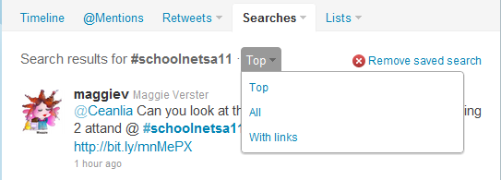

Intel ICT in the Classroom Conference 2011
How do you follow the conference stream?
Everything that will be happening will be in the conference stream!!!!!
Once you are in the conference stream, click on ALL to see everyone's tweets
If you just want to see tweets with links in them (resources) click on With links
To open the link, click on it
If you do not see your tweet in the conference stream it means that you have not added the hashtag #schoolnetsa11 to it (anywhere)
Notes:
To copy (for novices) just highlight the tweet and push Ctrl-C on your keyboard. Then click in the message window and push Ctrl-V to paste the tweet into the window. Add RT to the front of the message.

Slide 19
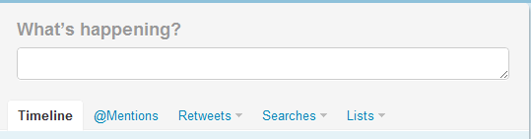


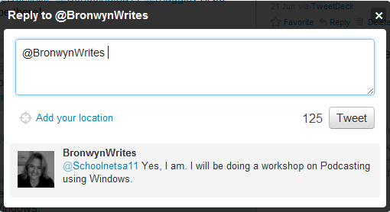
Intel ICT in the Classroom Conference 2011
How do you have conversations with someone?
You will find tweets directed at you under
Mentions
Hover over the tweet to you and click on Reply e.g. @c4lpt (for Jane Hart)
Or add their @theirtwittername
to your tweet
Add the rest of your reply.
Can’t wait!!
Notes:
To copy (for novices) just highlight the tweet and push Ctrl-C on your keyboard. Then click in the message window and push Ctrl-V to paste the tweet into the window. Add RT to the front of the message.

Slide 20
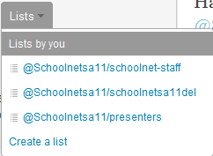
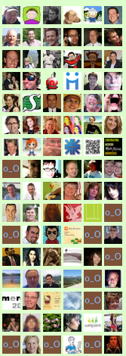
Intel ICT in the Classroom Conference 2011
Connecting with other delegates
Click on a list and follow
Go to www.twitter.com/schoolnetsa11
Click on lists.
Follow the interesting people at the conference!!
If you do not see your tweet in the conference stream it means that you have not added the hashtag #schoolnetsa11 to it (anywhere)

Slide 21
Intel ICT in the Classroom Conference 2011
What can I do with a conference tweet?
Make the most of creating your conference network!
Ask questions
Answer questions
Comment
Summarise main points
Share resources
Make connections
Keep track of last minute happenings
Network Network Network!!!
See you in the conference twitterverse! This tutorial has been prepared by @maggiev For more tutorials see www.ict4champions.co.za

